Slide 1


Computer Science in the Real World
Russell Feldhausen (@russfeld) Have a Byte 2019
Notes:
A little over a year ago, I was contacted by Dr. DeLoach, the computer science department head, to help solve an interesting problem...

Slide 2
The Problem
How can we provide CS courses to a rapidly growing number of non-CS majors using limited resources?
Notes:
Classes are too full, few complete minor
Growing demand for CS skills
<quote>
Can’t just hire more faculty

Slide 3
The Problem
How can we teach Computer Science effectively in an online format?
Notes:
Classes are too full, few complete minor
Growing demand for CS skills
<quote>
Can’t just hire more faculty

Slide 4

If you wish to make an apple pie from scratch, you must first invent the universe.
Carl Sagan
Notes:
Think outside the box
<quote>
Rethink education, challenge assumptions
SIGCSE session – rebuild education from the ground up after catastrophe

Slide 5

The Ideal Form of Education
Source: https://giphy.com/gifs/dreamworks-lets-do-this-kung-fu-panda-master-shifu-QxZ0nbcVgMlPlnfZos
Notes:
Ideal form – one student, one master
apprenticeships

Slide 6
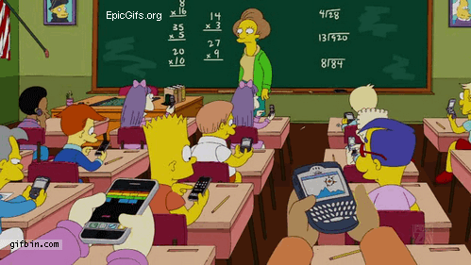
A Scalability Problem
Computer Scientists like those!
Source: https://giphy.com/gifs/the-simpsons-class-dont-care-W1VdPHo8Ft3Es
Notes:
How to teach more students?
Maximize educational quality while teaching more students
I love scalability problems

Slide 7
The Traditional Approach
Few Students
More Students
Small Lessons
Instant Feedback
Customized Curricula
Develop & Engage
Individual Skills
Large Classes
Turn In & Wait
Published Textbooks
Lecture & Grade
Credit Hours
Notes:
Traditional approach – few students, quality education
Scale up – becomes large classes, inflexible, too much time lecturing and grading

Slide 8

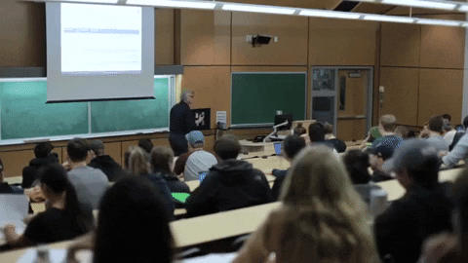
Online Learning?
Source: https://giphy.com/gifs/uviccampuslife-classroom-lecture-uvic-piZ2mYa0R9zzBpT9yb
Notes:
Apply that to online learning – poor quality
Hybrid – students feel like second class citizens

Slide 9
Remote Teaching
Source: https://giphy.com/gifs/uviccampuslife-classroom-lecture-uvic-piZ2mYa0R9zzBpT9yb
Notes:
Apply that to online learning – poor quality
Hybrid – students feel like second class citizens

Slide 10
The Online Approach
Few Students
More Students
Small Lessons
Instant Feedback
Customized Curricula
Develop & Engage
Individual Skills
Small Lessons
Instant Feedback
Customized Curricula
Develop & Engage
Individual Skills
Notes:
Can we take the things that make education on the small scale so good, and scale it up so that it works online using technology?

Slide 11
Online Pedagogy
More, Shorter Videos
Multimodal Content
Asynchronous & Synchronous
New Assessment Methods
Notes:
Classes are too full, few complete minor
Growing demand for CS skills
<quote>
Can’t just hire more faculty

Slide 12
Accessibility
Time Management
External vs. Internal Motivation
Feedback (Automated?)
Mastery vs. Performance
Assessing Learning Outcomes
E-Textbooks vs. Custom
Online vs. Installed IDE
Concerns
Notes:
Small lessons, not omnibus lectures
Students can work at own pace
One module due each week

Slide 13
Online Teaching Styles
Traditional Face-to-Face
Remote Teaching
Fully Online Learning
All or nothing
Notes:
Bring it all together in a capstone
Drive learning outcomes
More faculty time here, less elsewhere

Slide 14
Online Teaching Styles
Traditional Face-to-Face
Remote Teaching
Fully Online Learning
All or nothing
Flipped/Blended/Hybrid
Hyflex
MOOC?
Best of both worlds
Notes:
Bring it all together in a capstone
Drive learning outcomes
More faculty time here, less elsewhere

Slide 15
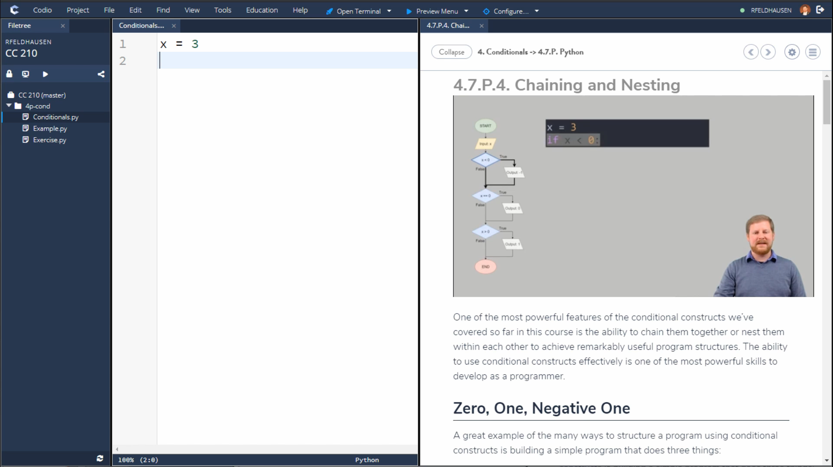
Notes:
We want to build that
Teach cs while being scalable
Follow tutorials and videos on right
Write code on left
Work directly in browser

Slide 16
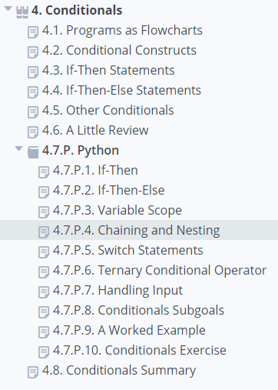
Small Lessons
Notes:
Small lessons, not omnibus lectures
Students can work at own pace
One module due each week

Slide 17
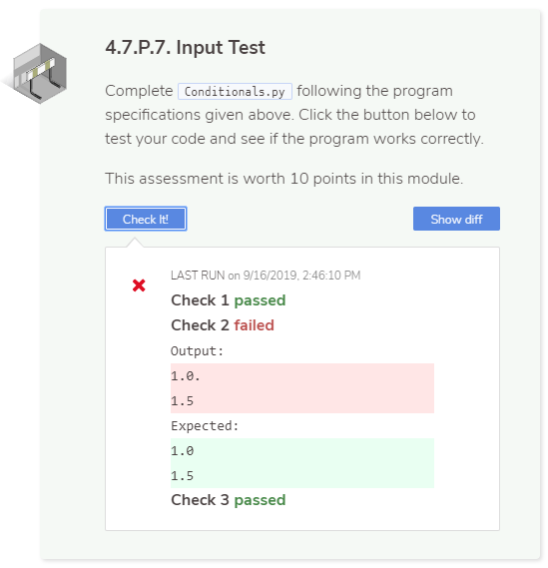
Instant Feedback
Notes:
Autograde programs to get feedback
Try and learn from mistakes

Slide 18
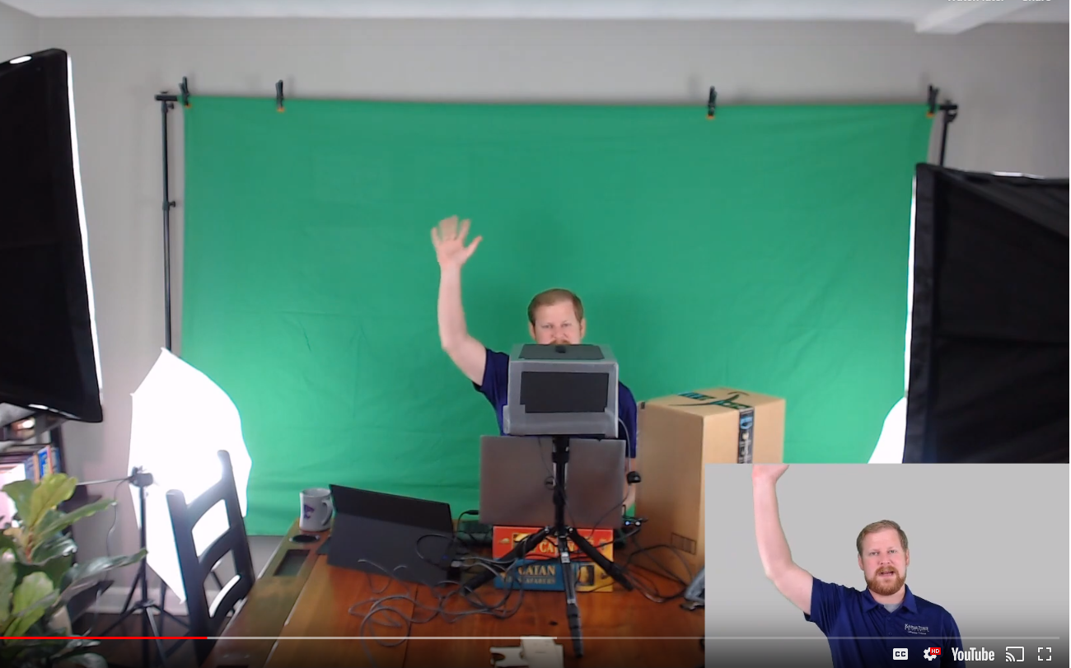
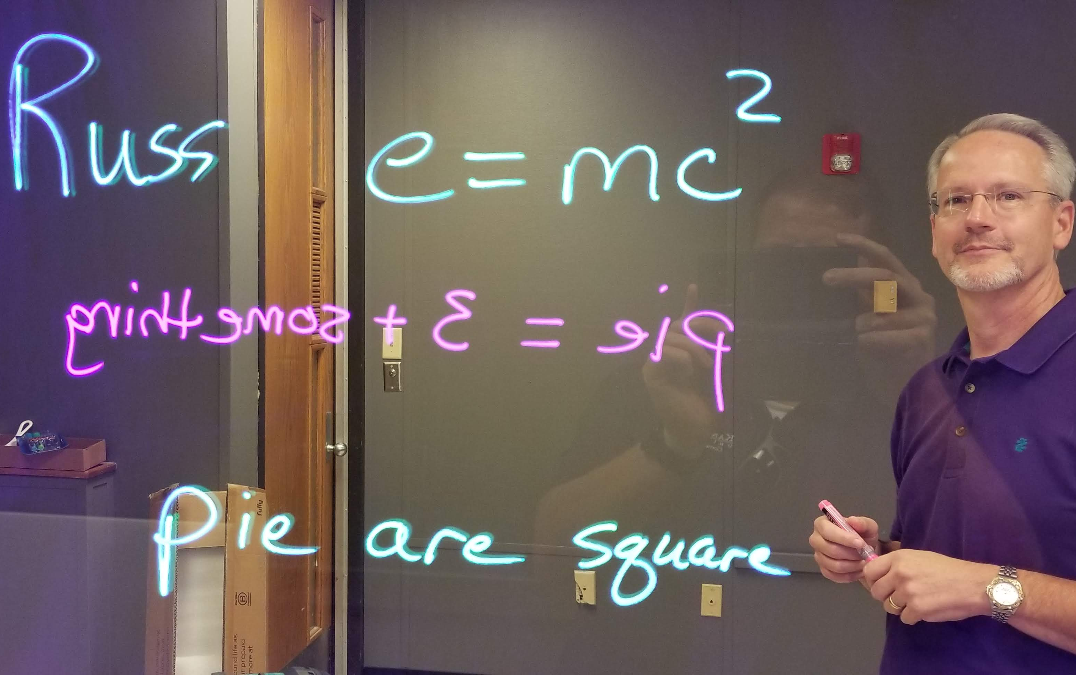
Develop & Engage
Notes:
5 classes, 2 faculty
Spend time developing material and engaging with students

Slide 19
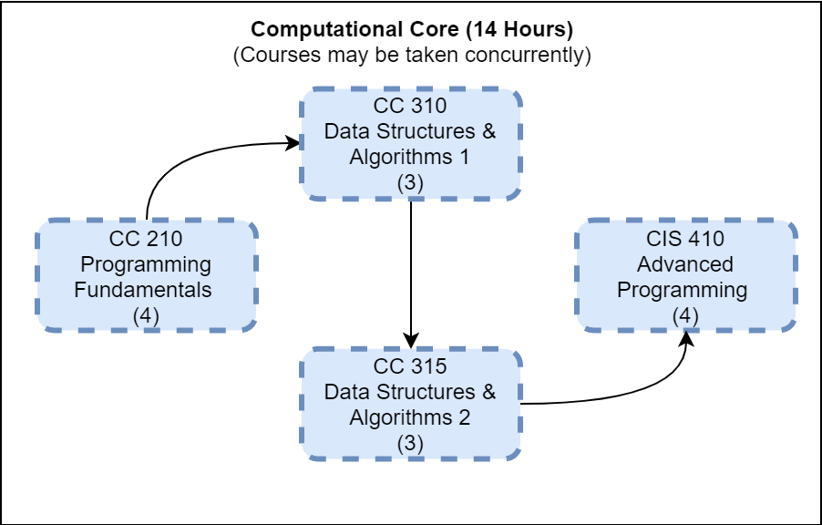
Customized Curricula
Notes:
Customize curricula to meet needs
Allow concurrent enrollment

Slide 20
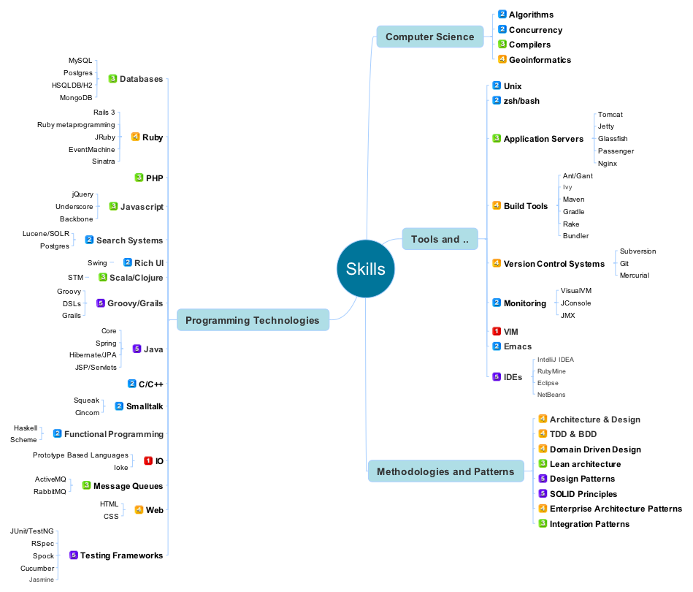
Individual Skills
Source: https://www.pixelstech.net/article/1327753273-30-Minute-Exercise-to-Become-a-Better-Programmer
Notes:
Do this by focusing on skill prerequisites instead of course prereqs

Slide 21
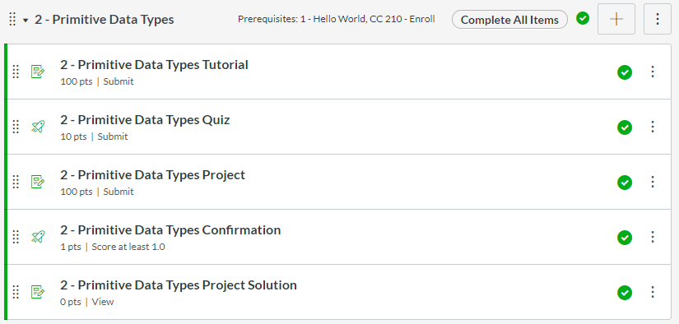
… using Modules & Prerequisites
Notes:
Can do this in Canvas already

Slide 22
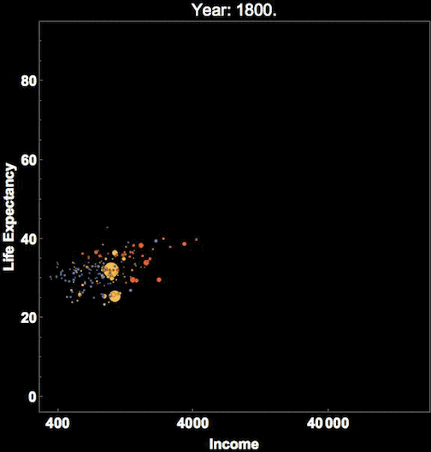
Certificate Capstone Project
Identify Solvable Real World Problem
Select Data Structures & Algorithms
Implement Software to Specification
Debug & Test
Source: https://giphy.com/gifs/wolfram-research-data-visualization-3o6Ygfw40tlnPhX87m
Notes:
Bring it all together in a capstone
Drive learning outcomes
More faculty time here, less elsewhere

Slide 23

Available Today!
Computer Science Undergraduate Certificate
4 Courses, 14 Credits (5 courses, 17 Credits in Fall 2020)
Any K-State Student
Java or Python
100% Online
Designed for Non-CS Majors
FREE TRIAL!
Notes:
Available now!
Free trial

Slide 24
Possible Future Plans*
Applied Computer Science Degree (with Arts & Sciences)
High School Programs
Teacher Training Programs
Industry Certifications
Additional Programming Languages
Upper Level CS Courses
Cross-Discipline Capstone Projects
…and more!
*Subject to change – nothing is set in stone yet
Notes:
Many ways to expand these courses in the future.
Good return on investment

Slide 25
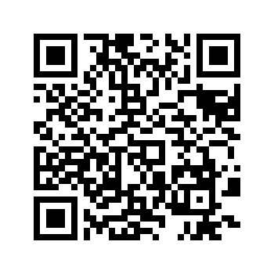
CC 210 Free Trial!
Russell Feldhausen
@russfeld
russfeld.me/talks/continuouslearningcs2020
CS Certificate Promo Video
bit.ly/ksucs-cert-promo
More Information
global.k-state.edu/engineering/computer-science
cs.k-state.edu/core
Must be current K-State Student, Faculty, or Staff
Thank You!
Notes:
Sign up for free trial
Find me online @russfeld

